Slide 1
Riding the next wave: PaaS with Cloud Foundry
@Kendrick Coleman

Slide 2
Software is
EATING
the world…
- Marc Andreessen

Slide 3
DEVELOPERS
DEVELOPERS
DEVELOPERS
DEVELOPERS
DEVELOPERS
DEVELOPERS

Slide 4
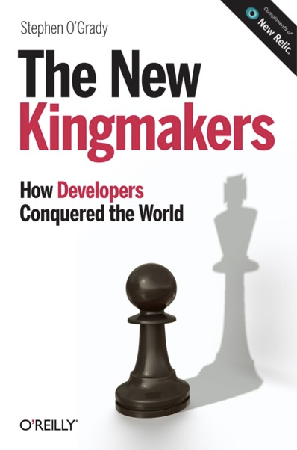
DEVELOPERS
BECOME

Slide 5
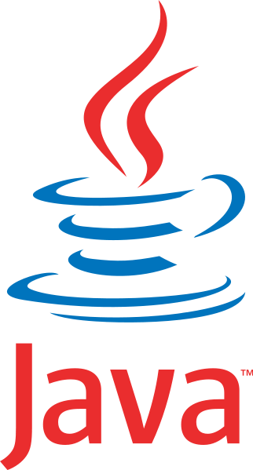
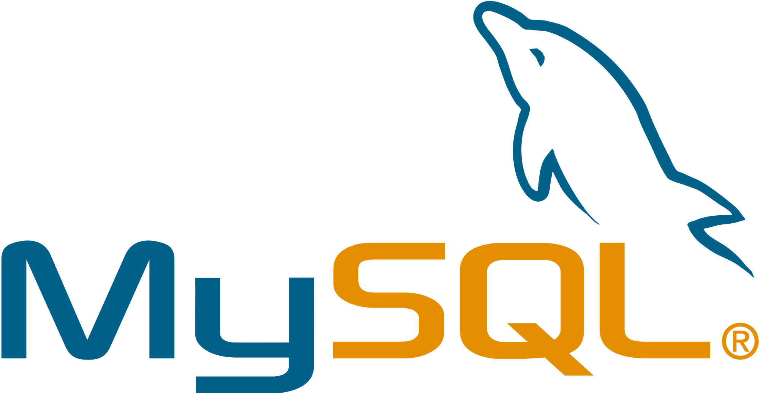
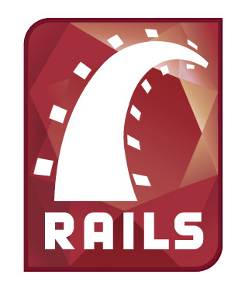
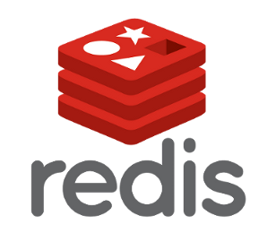
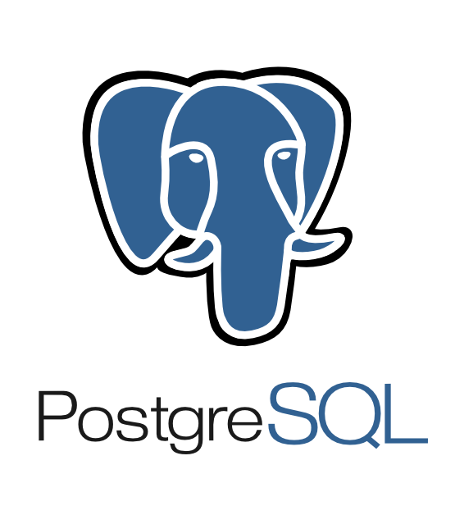
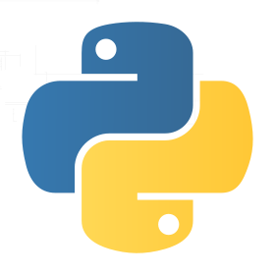
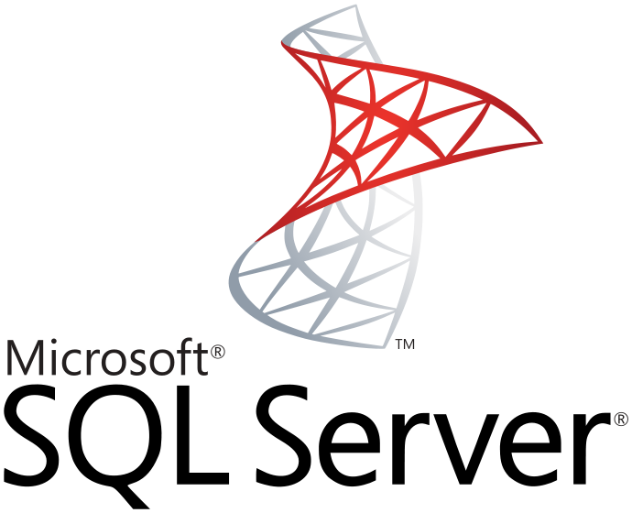
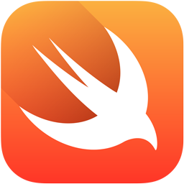
OLD vs NEW
2nd Platform – Traditional Applications
Structured / Tables / Consistent
Relational
Centralized
Traditional Enterprise Systems
Licensed
3rd Platform – Web & Mobile Apps
Unstructured / Object / Variable
NoSQL
Distributed / Micro Services
Commodity Systems
Open-source
Notes:
You may ask “why do we need a new infrastructure for third platform?”.
This slide introduces our next 3rd Platform trend, Big Data” and gives a great example of why a new infrastructure solution is needed by focusing on the difference between traditional vs 3rd platform data structures.
The list on the left is traditional data structures, and on the left is “Big Data” or third platform data structures.
(read through the 2 lists on the slide)
As you can see, there is a significant contrast between the two platforms, and this difference drives two very different infrastructure stacks seen on the next slide

Slide 6
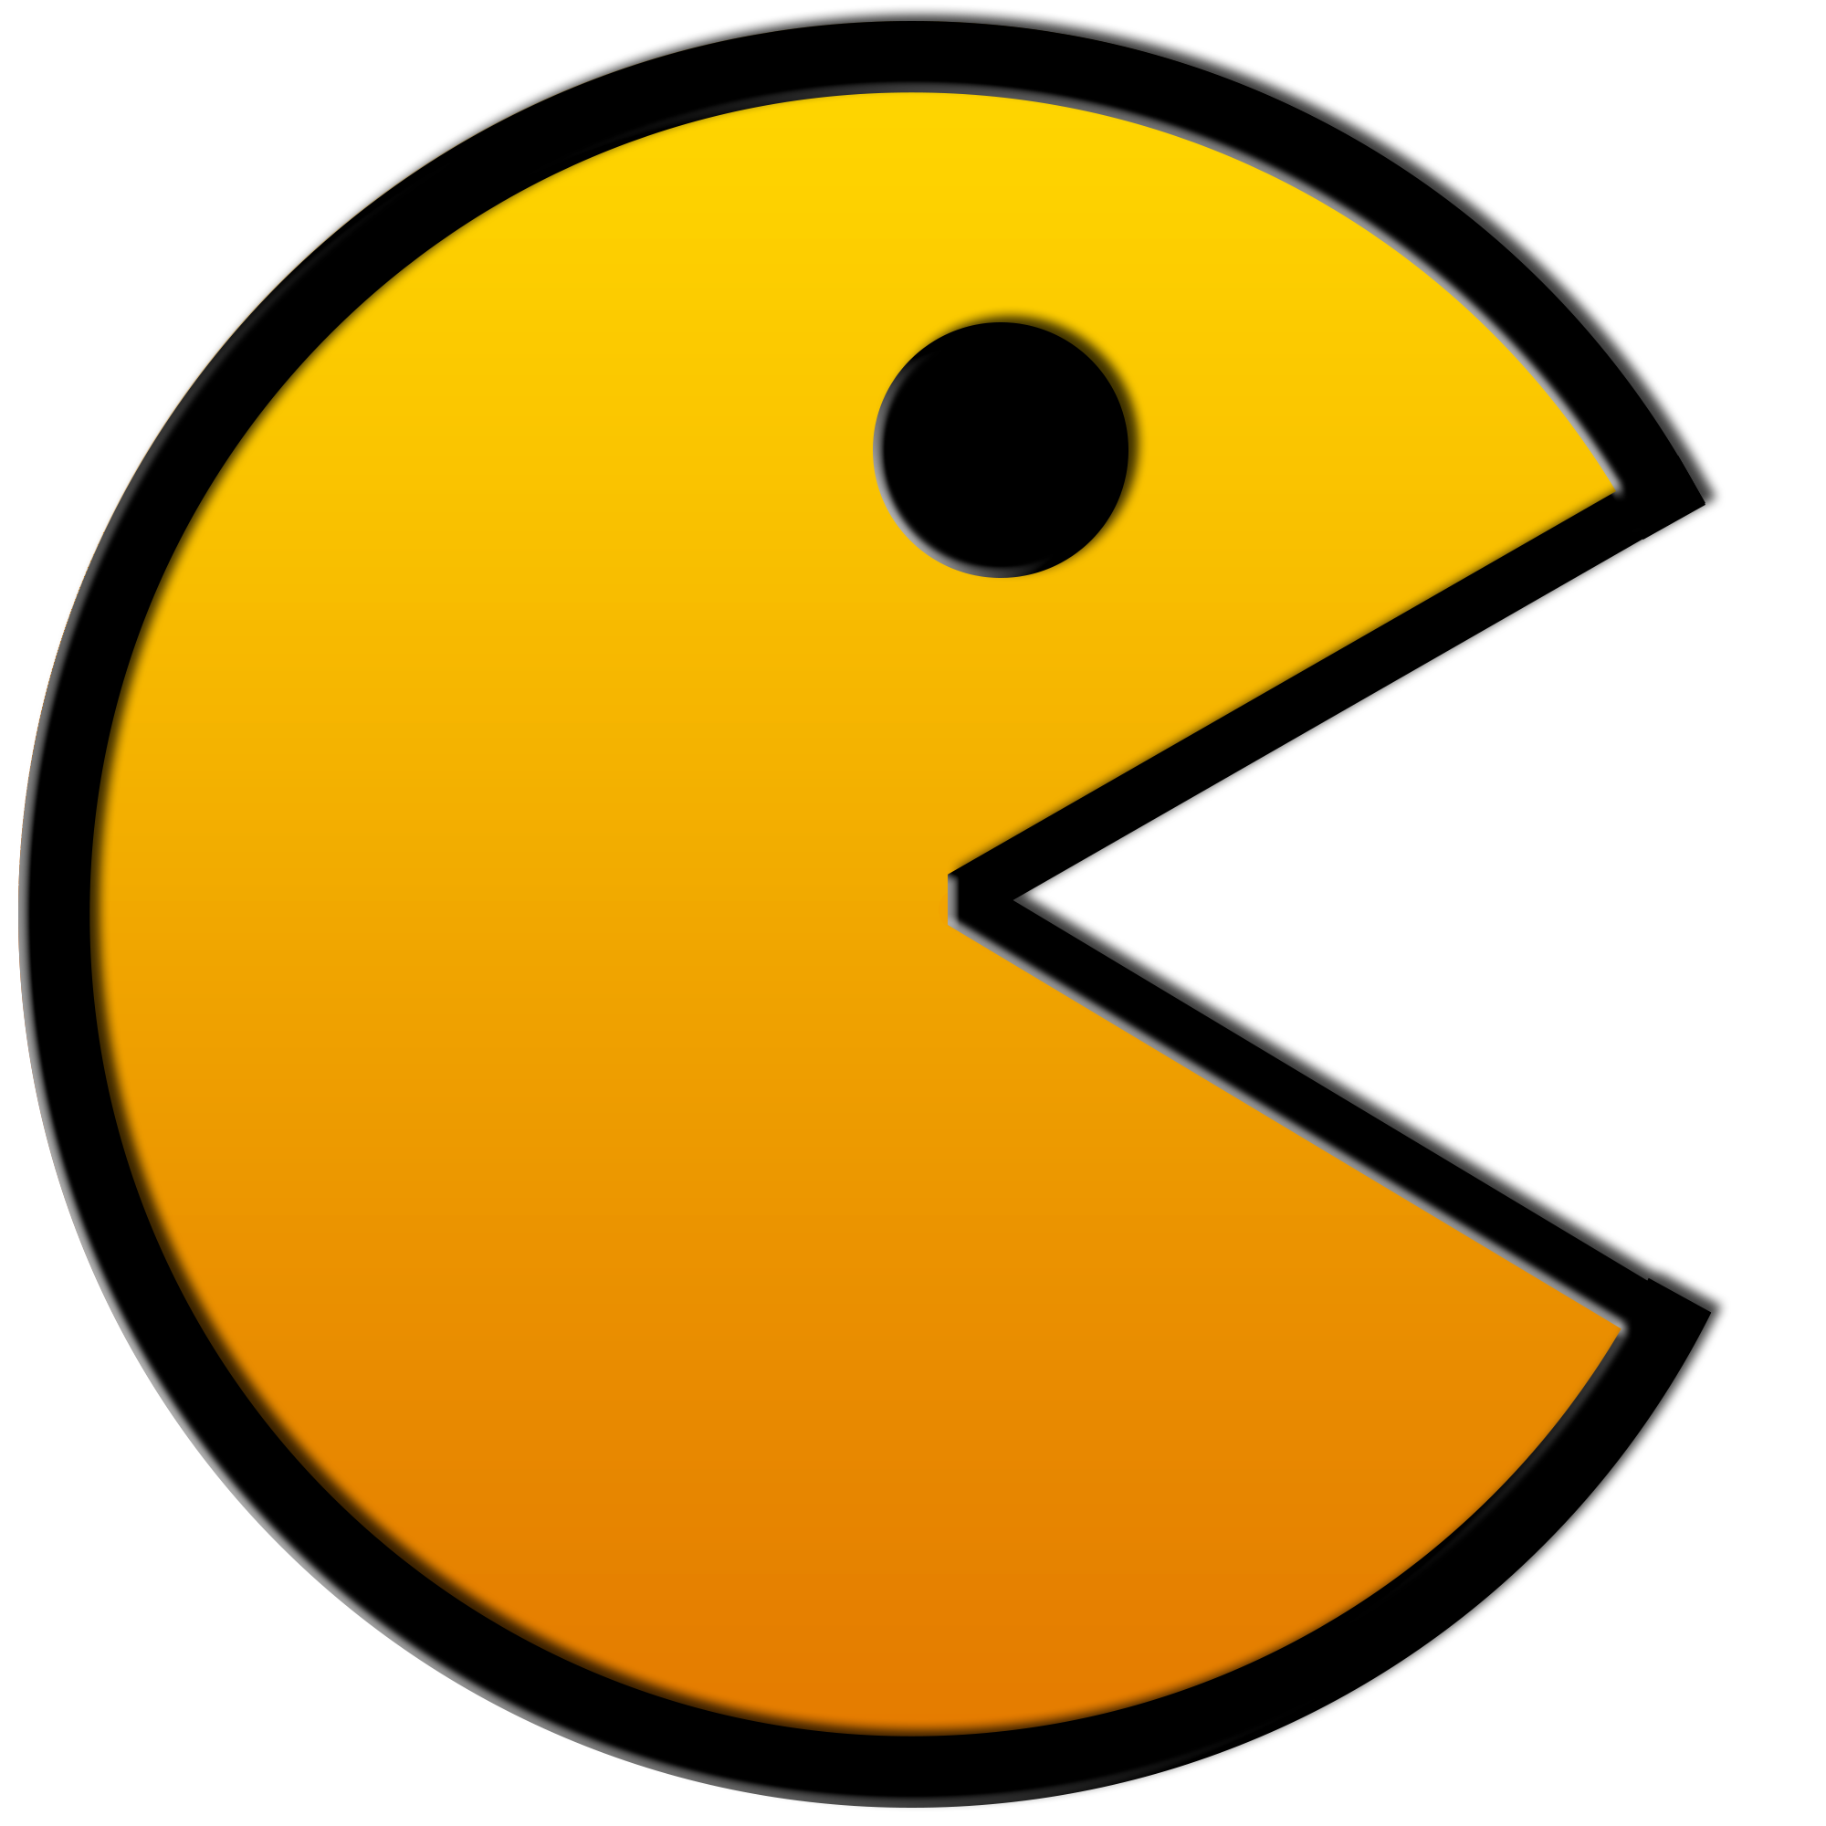
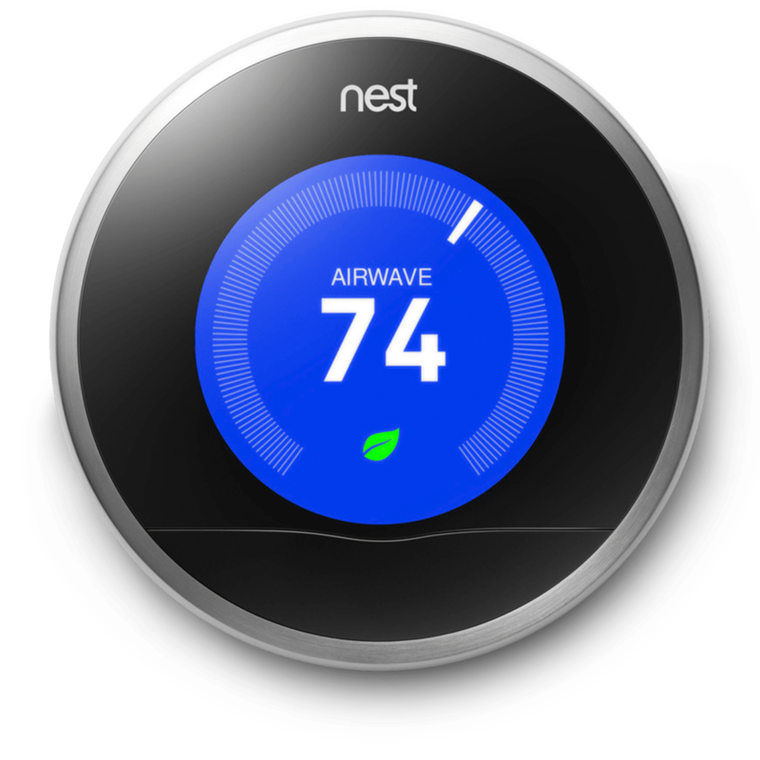
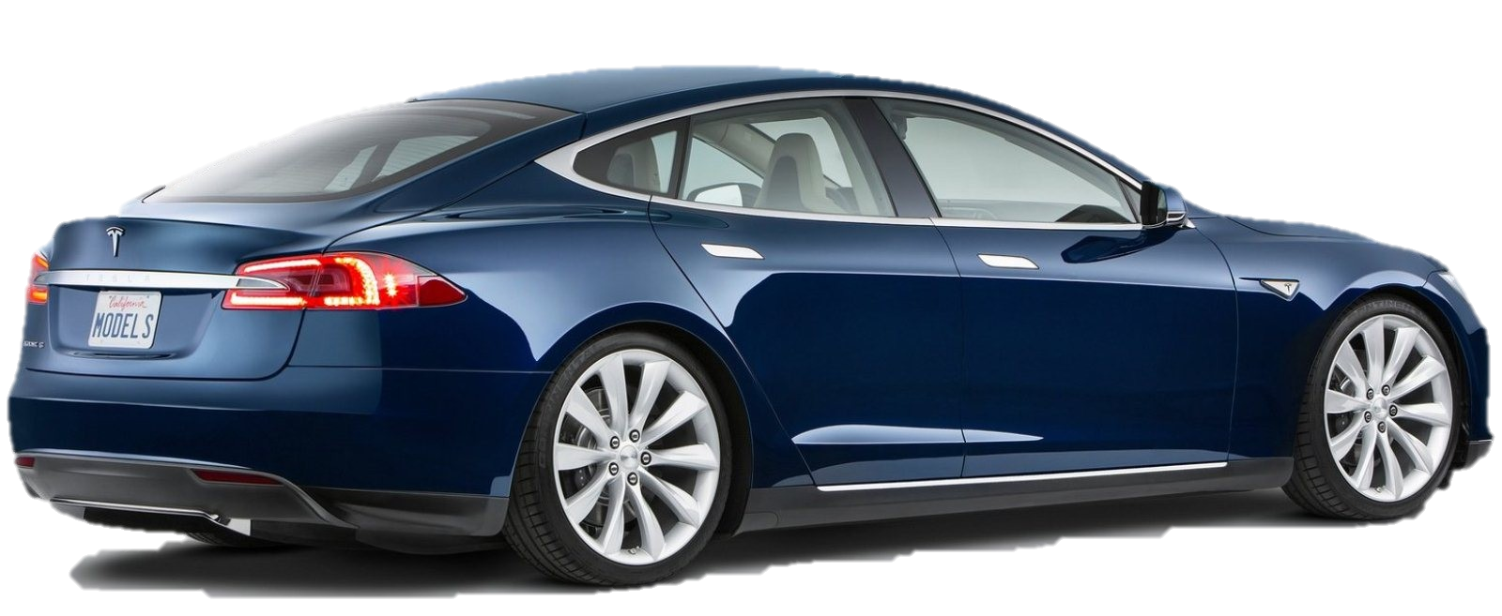
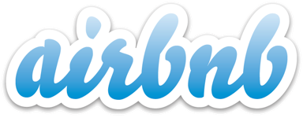
NOM
NOM
NOM
NOM
NOM
Home Automation
Automotive
Transportation
$3.2B Acquisition by Google
$26B Valuation
$19.5B Valuation
Financial Services
Entertainment
Hospitality
$3.2B Valuation
$20B Valuation
$3.5B Valuation

Slide 7
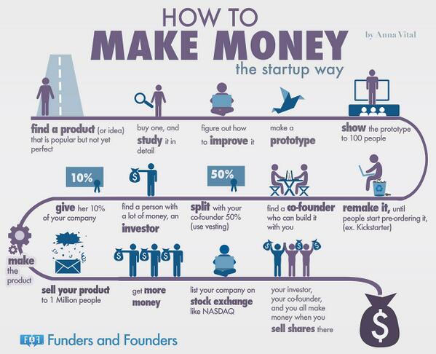

Slide 8
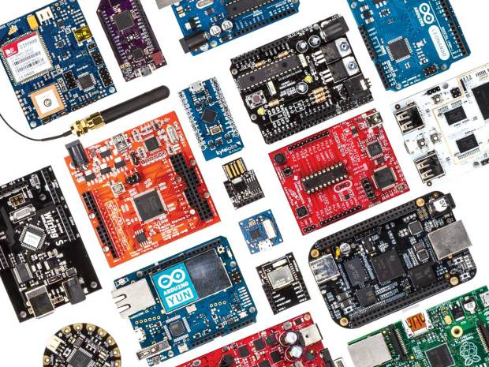

Slide 9
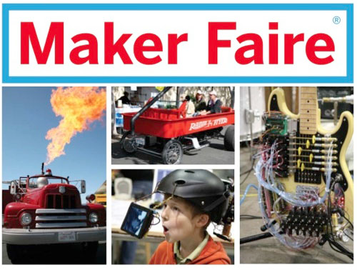

Slide 10
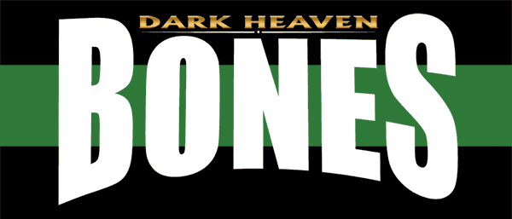
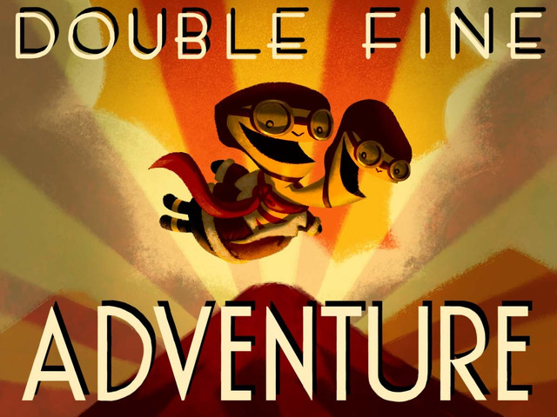
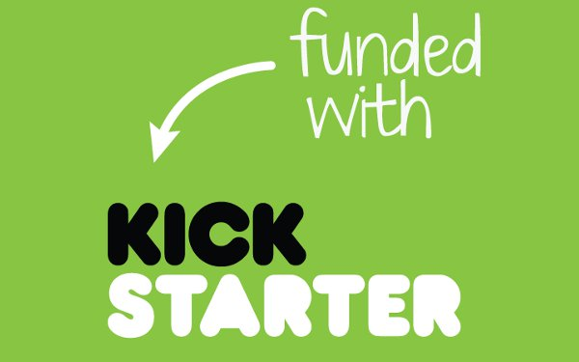
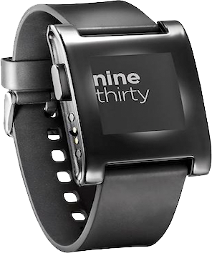

Slide 11
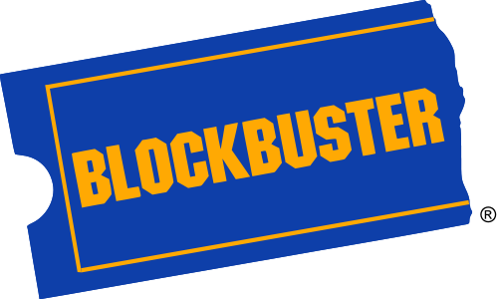
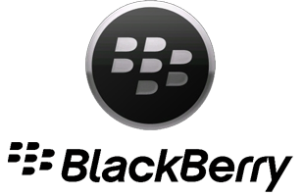
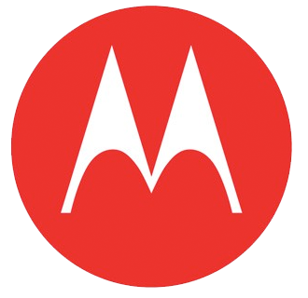
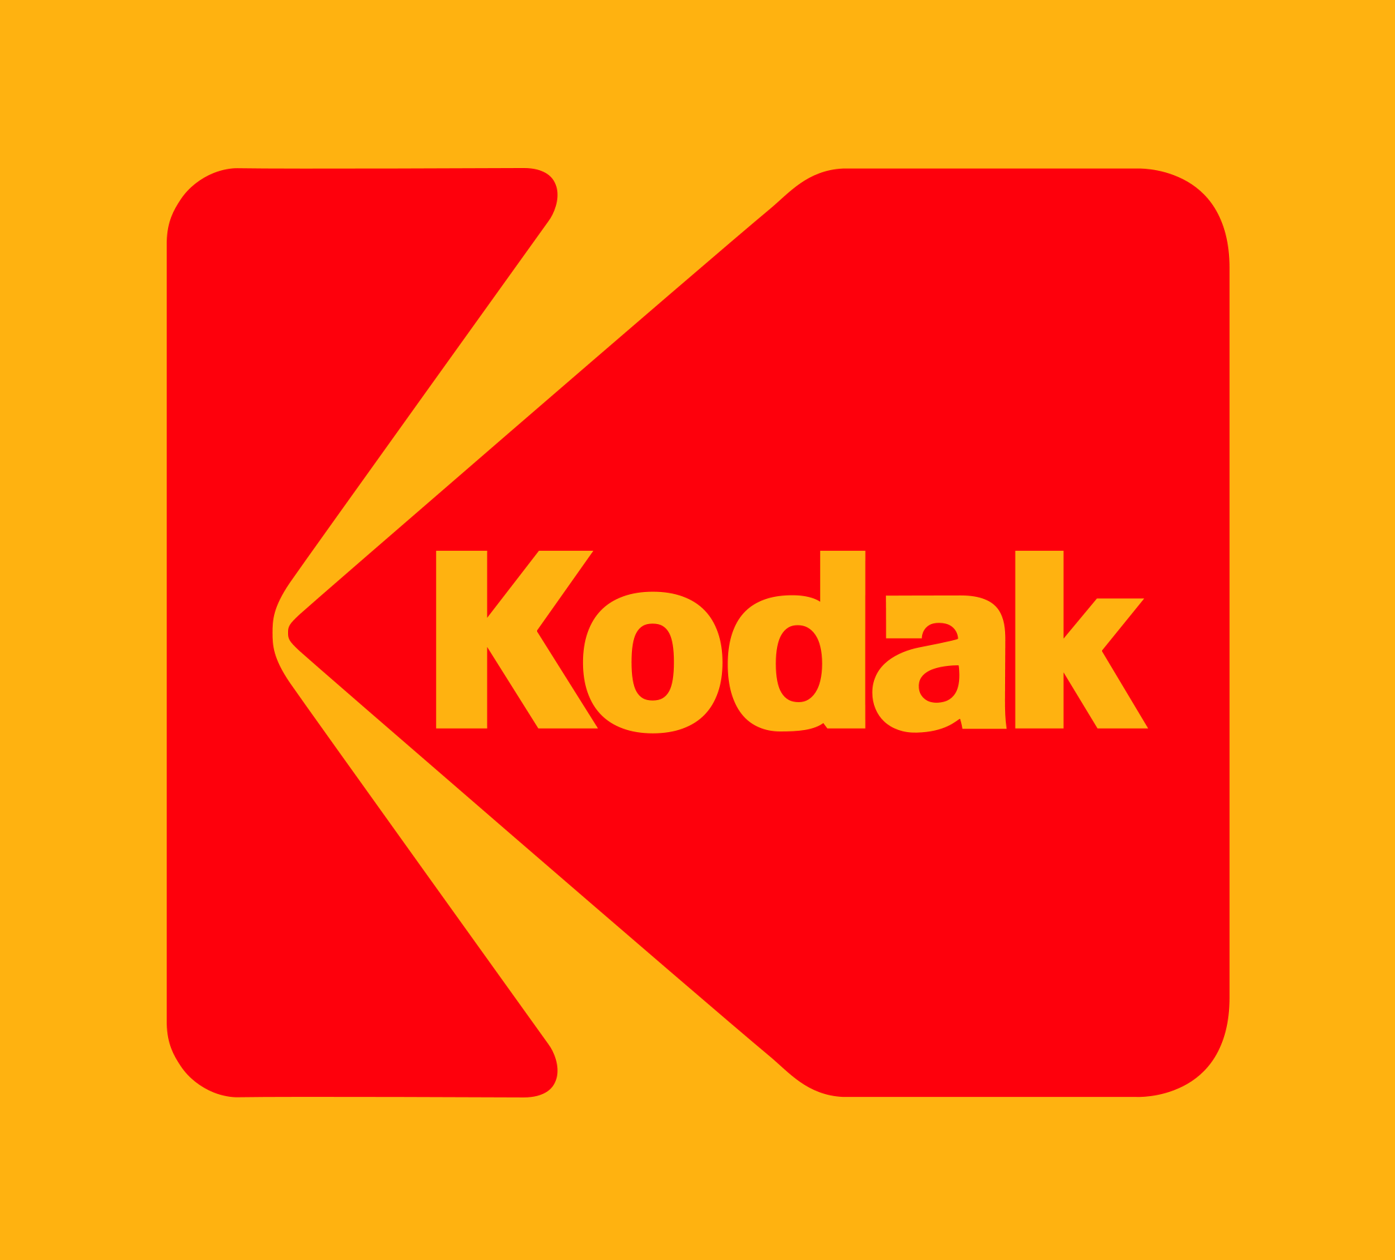
Leaders BECOME CHASERS
Notes:
Blockbuster: This video-rental chain survived the transition from VHS to DVD just fine—but then failed to adapt to the next big change. Blockbuster remained flat-footed when Netflix started sending videos through the mail, cable and phone companies started offering video-on-demand, and Redbox started renting videos for a buck a night through vending machines.
Motorola: Motorola dominated cell phones as recently as 2003, when it introduced the trendy Razr, the biggest-selling mobile phone ever at the time. But Motorola failed to focus on smartphones that can handle E-mail and other data, and rapidly lost share to newcomers like Apple, LG, and Samsung. Motorola was vanquished so swiftly that its cell phone division became a perennial money-loser and the firm announced plans this year to spin it off into a separate company, allowing the core Motorola to focus on networking equipment and a few other areas.
Kodak: In the past 15 years, digital technology changed photography dramatically, and Kodak, a former heavyweight in the analog film business, got left behind.
RIM: Who didn’t have a blackberry? When Apple debuted the iPhone, it was curtains for this giant cell phone provider.
Yahoo: When Web search and aggregation were still virgin territory, the pioneering Yahoo tried to charge for services like E-mail and file sharing, while upstart Google offered everything for free. Customers flocked to Google, which surged to a commanding lead in search that it still holds. Yahoo still grew into a huge Web portal, with strong sports, financial, and news coverage that generates billions in advertising revenue, but it also drifted into job-hunting services, video streaming, original entertainment, and other ventures it has since sold or folded.

Slide 12
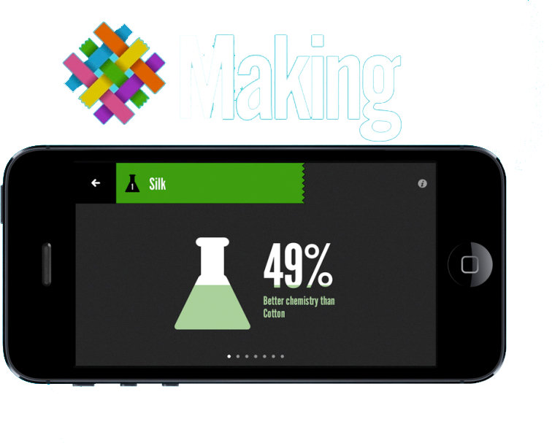
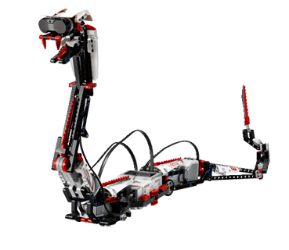
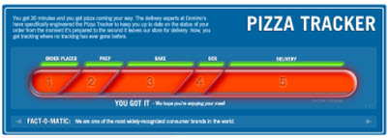
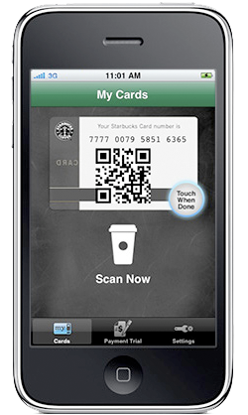
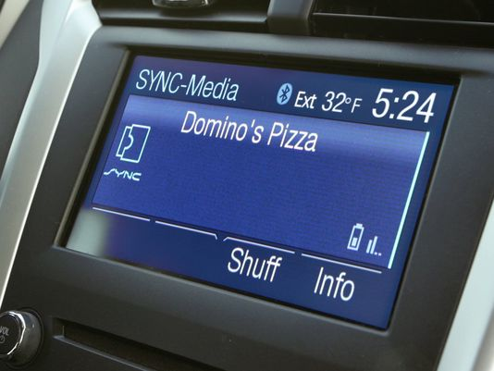
REINVENT & INNOVATE
Nike
National Geographic
American Express
Dominos
Lego
Starbucks
Notes:
Nike: Typically always been a shoe and athletic apparel brand. To keep up with the growing trend of wearables, Nike launched the Fuelband on in January of 2012. automatically synchronizing with the Nike Activity tracker mobile app. Nike Inc.'s Equipment division saw an 18% rise in profits for the 2012 fiscal year after introduction of the Nike+ FuelBand, in comparison to the -1% loss during the 2011 fiscal year.^{[9]} Before the FuelBand's official American release, it was open for pre-order online, and was sold out both times within the same day.^{[10][11]} A consumer on Twitter timed one of the pre-order periods to be exactly 4 minutes before all FuelBands were sold out and Nikestore.com was overloaded due to customer traffic.^{[12]} Nike+ FuelBands were being sold on eBay during the first couple of months after pre-order for approximately double the retail price.^{[13]}
Nike's most exciting new product last year wasn't a LeBron James sneaker (although the 11s are pretty sweet). It was an app called Making that helps companies measure the environmental impact of using different materials--which made up approximately 60% of Nike's footprint and spurred the creation of the app. "Before, if you asked, 'Which is better, hemp or cotton?' nobody had that at hand," says Hannah Jones, Nike's VP of sustainable business and innovation. "We created this enormous database of materials and turned it into an index for the entire industry." Released last summer, the app evolved out of Nike's push to eliminate the use of hazardous chemicals in the creation of its products by 2020 and has been incorporated into the curriculum at two design schools and downloaded in 23 countries.
National Geo: National Geographic Society CEO John Fahey didn't wait around for his publication to suffer the same fate as iconic photo magazines like Life. Instead, he spearheaded an effort to reinvent the National Geographic brand across all media platforms, especially the National Geographic Channel, launched in 2001. Meanwhile, social networking and photo-sharing sites have given National Geographic a whole new way to showcase its gorgeous, award-winning photography.
American Express: American Express is giving cardholders who also use Twitter a good reason to sync the two services, with the ability to purchase gift cards and products using only a hashtag. cardholders first sync their account to Twitter, then tweet a special product hashtag from the product they wish to purchase with their Amex card.
American Express will then reply via the @AmexSync account with a confirmation hashtag, after which time users have 15 minutes to tweet their own response.
Once confirmed, the purchase will be charged to the synced card and sent to the billing address on file via free two-day shipping courtesy of American Express.
Dominos: In 2008, Domino's introduced the Pizza Tracker, an online application that allows customers to view the status of their order in a simulated "real time" progress bar. At the time, no one else in the industry has created such an innovation. Available soon, Domino’s customers who have a registered Pizza Profile on their Domino’s mobile app, as well as the Ford SYNC® AppLink™ in-car connectivity system, will be able to use that combination to place their saved Easy Order™ in just a few simple, voice-activated steps.
Lego: R3ptar. The robotic snake, which can be programmed from a smartphone app, is equipped with a snapping mechanical jaw and fangs that will send even the boldest kid brother packing. R3ptar is among the new creations the Danish toymaker is counting on to stay relevant in the Internet age. The R3ptar snake can be built from a 601-piece kit introduced this year that includes sensors, software, and motors to control the robot’s movement and speech. Known as EV3, the $350 set is the third incarnation of Lego’s Mindstorms series, introduced in 1998. It includes instructions for creating five walking, talking, and thinking robots, including the snake, the scorpion-like Spik3r, and the mohawk-sporting Ev3rstorm. Broadening its product range to attract older users with more complex kits is helping Lego grow faster than competitors Mattel (MAT) and Hasbro (HAS). Lego’s success “lies in embracing what digital can do,” Chief Marketing Officer Mads Nipper says over coffee in his toy-filled office at the company headquarters in Billund. As evidence, he points to the 20 million monthly visitors to Lego’s websites and the 100 million-plus copies of video games sold by its licensing partners
Starbucks: App to order, pay, and everything at their B&M store.
Apple: Remember when the experts, having peered at the iPhone 4, declared that smartphone design was now set? To paraphrase Steve Jobs, they forgot one more thing: the button.
Apple, by making the one control on the front of its iPhone 5S a fingerprint sensor, has pulled off a neat trick. It provides a glimmer of magic every time a user unlocks her phone with just a light touch. And it helps explain why Apple is estimated to be selling two-and-a-half times as many 5Ss as its candy-colored, less-expensive cousin, the 5C, which doesn't yet have Touch ID, as the futuristic feature is known. And Touch ID makes it even easier for customers to use their Apple ID to download apps and entertainment, which together comprise more than $10 billion in annual sales for the company.
Apple is poised to grow its business around other trends as well. In the last quarter of 2013, its China sales were $8.8 billion, up 29 percent over a year earlier. In January, Apple began selling its iPhones through the country's largest carrier, China Mobile, which has 760 million subscribers. That's more than double the population of the United States, a potential bonanza.
Apple has also quietly begun building its own content delivery network. Previously, the company has relied on outside venders to distribute apps and video and to handle the iCloud service. Having its own network would give Apple more control and pave the way for its long-rumored TV service.

Slide 13
Innovation relies on Speed
Notes:
Innovation relies on speed to execute. How fast does it take an application developer to take their code and push it to production?

Slide 14
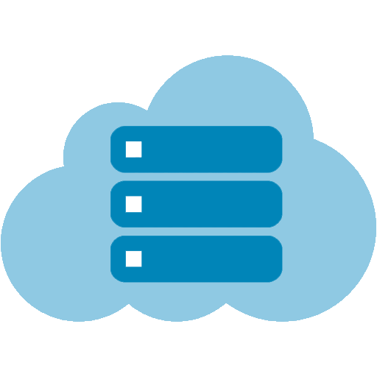
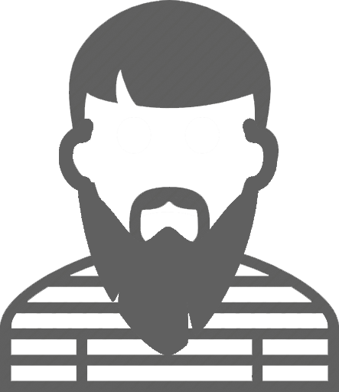
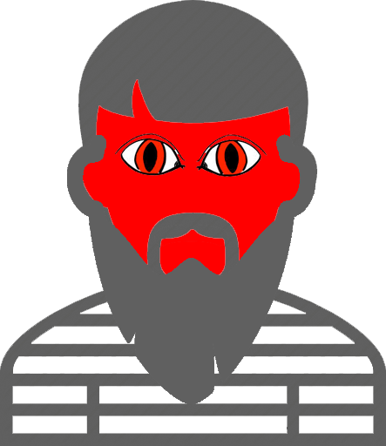
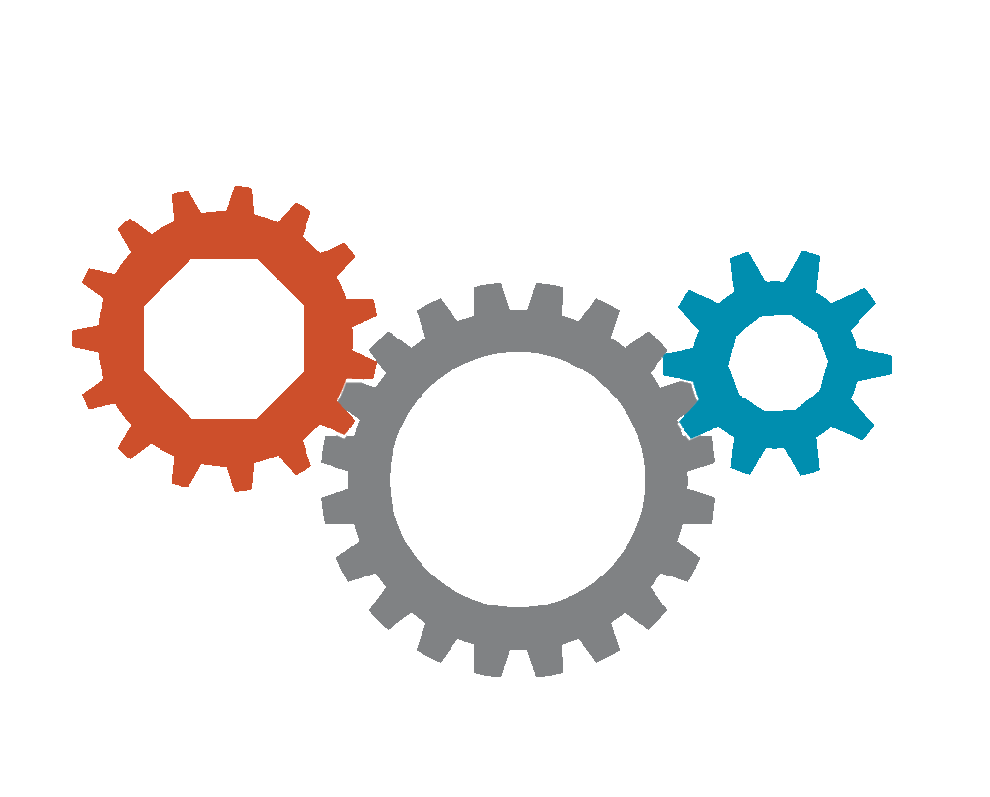
Notes:
Typically developers will go to IT for a particular service. IT will go through their processes to spin up those resources. We all know that processes take time. Developers get frustrated when they have to wait. So they go to an external service and that makes IT sad.

Slide 15
GIVE Developers what they need
Notes:
We must give developers the speed they need in a much faster amount of time. And wrapping it all off with a bow is exactly what we need to accomplish

Slide 16
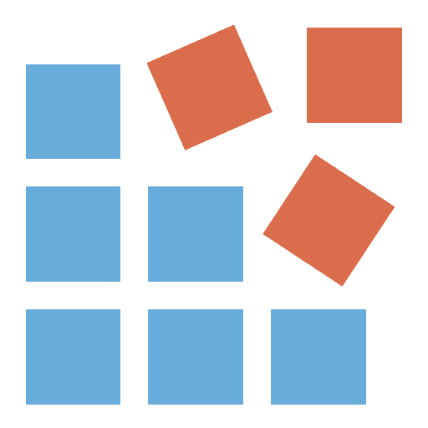
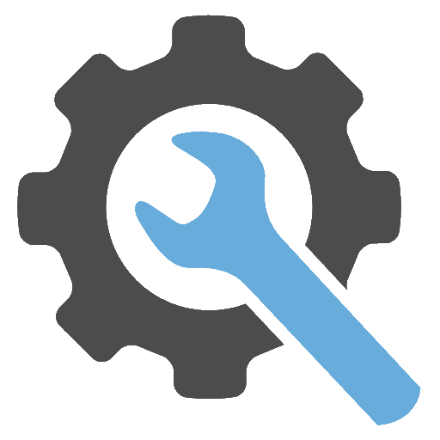
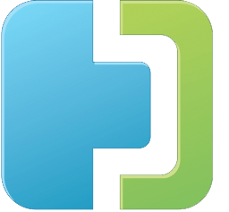
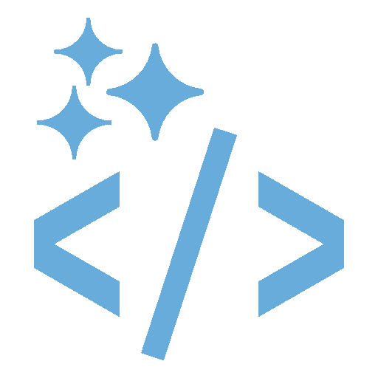
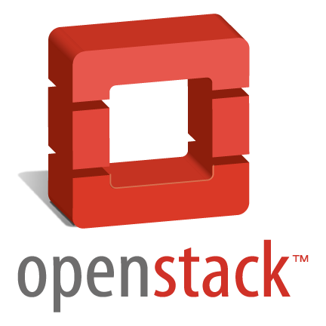
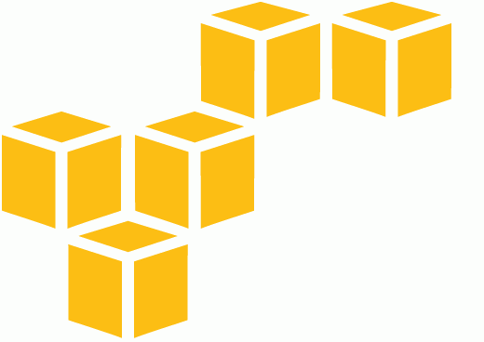
The answer
may not
be iaas
Woof
Moo
Notes:
Whether you are using vSphere, vCAC, vCloud Hybrid Service, OpenStack, or Amazon’s Elastic Compute Service, there is one thing they all have in common. Each of these services spins up Virtual Machines to run code. Depending on the type of application, this virtual machine could be classified as a pet or as cattle.
No matter what, IT is responsible for:
getting the code on these VMs (whether it’s automated or manual)
The interdependencies of the operating system and setting up the application environment. This can be manual or automated through configuration management such as chef, puppet, or ansible.
The time it takes to build this orchestration to make an automated IaaS system. And the time it takes to maintain all of this.
The operational status of any VM is important because it could mean curtains for an application.
And the sheer volume of virtual machines to manage. Think if you had a development initiative that will end up creating 100 different scalable Web Apps. If each of those apps followed the three tier model (and that’s without scaling) we are starting off with 300 new VMs to manage.
IaaS may not really be the answer

Slide 17
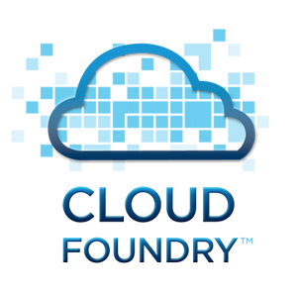
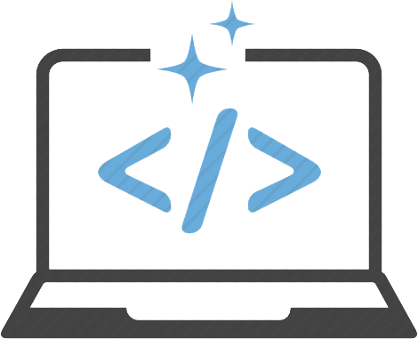
The power of
myapp.mycompany.local
MyApp
MyApp
MyApp
MyApp
PAAS
………………………….
cf push MyApp –i 4
cf push MyApp
…………………….
…………………….
Notes:
So what’s another answer? A developer has been working furiously on his code and he’s got a completely working development environment on his laptop. It’s go time. How do we get this code to production faster?
IT has been hearing good things about Cloud Foundry and decides to spin up an instance. IT tells the developer to install CFtools (cloud foundry tools) and from the application working folder, do a cf push. His laptop connects to the Cloud Foundry instance and begins building out the environment. Deploying the code using the language build pack, creating and configuring a database, and spinning up a container to run the application. After everything is running, a confirmation message is displayed on the developers console that they can access the application at myapp.mycompany.local.
Sure enough, the developer can go to the web address and see his application. Awesome, well what about scale? Do we have to figure out how to build orchestration tasks to deploy multiple instances behind a load balancer? Nope. Lets change our cf push to 4 instances. This will communicate with the Cloud Foundry instance and scale up the application to 4 instances. The built-in load balancer and router will be responsible for configuring everything and accessing myapp.mycompany.local is always available.
This is what I call The Power of Platform as a Service.

Slide 18
The power of
NO Virtual Machine
NO OS/App Dependencies
NO Security Patches
NO OS Upgrades
NO Portal
NO Custom Orchestration
Less Complexity
Focus on Building Applications
Simple Application Scaling
Inherit Container Separation
Complete Developer Control
Saves Computing Resources
Simple Platform Scaling
PAAS
cf push MyApp –i 4
cf push MyApp
Notes:
So what happened here.
No Virtual Machine was deployed during this entire process. You know what that means when you don’t have to worry about VM? Less things for operations to think about
It also means that you never have to worry about an Operating System and application dependencies. Does the app need Windows? Ubuntu? RHEL? CentOS? It doesn’t matter.
This also means you don’t have to ever worry about patch Tuesday or running apt-get update or yum update to keep security patches continually installed.
I know all of us have a Windows NT server sitting somewhere. Never worry about performing an operating system upgrade because something is no longer in support
Our developer never had to go to a portal and order a virtual machine and wait for it to be provisioned to run his code.
This means you don’t need to worry about heavy orchestration tasks to make a server ready to accept a type of application
All of this means less complexity in getting applications from the developer to actually running on the network
More time can be spent on building the applications instead of building the environments where these applications will run
Scaling the application is done through spinning up instances horizontally and increasing the amount of RAM required for each container vertically. Databases can also be scaled vertically through the application manifests
It’s inheritably multi-tenant by using containers to create separation. Today it’s warden, tomorrow it’s docker.
Our developer has full control of how his application runs through application manifests that tell how the application can scale
VMs will use CPU and RAM for the OS even if the application is sitting idle. Now that we’re using containers, more and more applications can be crammed into our DEAs (distributed execution agents) where the containers run.
The Cloud Foundry platform easily scales through a BOSH manifest

Slide 19
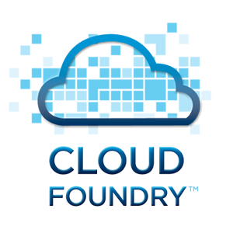
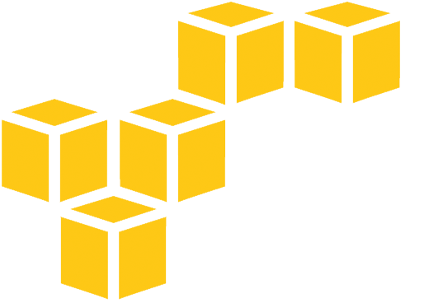
onsite
…….…….
oFFsite
MyApp
MyApp
MyApp
MyApp

Slide 20
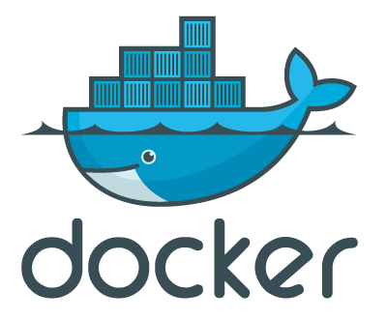
What’s NEXT?
Dockerfile
Notes:
provide a user experience based around cf push in a directory with a Dockerfile

Slide 21
DEMO TIME!

